Slide 1

Azure Machine Learning
Abdul Rasheed Feroz Khan
Director – Code$izzler
Twitter - @TechFero | @CodeSizzler
www.codesizzler.com
#CodeSizzler | #AzureML

Slide 2

Abdul Rasheed Feroz Khan
Founder & Director – CodeSizzler
Microsoft MVP – Azure
7+ years of experience in Training
Azure – IoT – Machine Learning – Cognitive Services – Bot – Xamarin – Big Data
#CodeSizzler | #AzureML
#csharpconf2017, @TechFero
#csharpconf2017, @TechFero Machine Learning with Azure

Slide 3
Content
Data Mining or Machine Learning
Loading data in Azure ML
Data preparation
Azure ML modelling
Deploying the models
R Scripts in Azure ML
#CodeSizzler | #AzureML

Slide 4
Data Mining or Azure ML

Slide 5
Why Machine Learning in the Cloud?
Integrated
Scalable Services
Discover and Share Samples
Notebook Developer Experience
Managed Services
Portable Models
#CodeSizzler | #AzureML

Slide 6
Machine Learning in Microsoft Azure
Fully managed
Integrated
Best in Class Algorithms + R
Built-in collection of best of breed algorithms. Support for R and popular CRAN packages.
Deploy in minutes
No software to install, no hardware to manage, and one portal to view and update.
Simple drag, drop and connect interface for Data Science. No need for programming for common tasks.
Operationalize models with a single click. Monetize in Machine Learning Marketplace.
#CodeSizzler | #AzureML
Notes:
Managed Scalable Machine Learning
Predictive Analytics at Scale
Build Machine Learning Models easily
Fully Managed Services

Slide 7
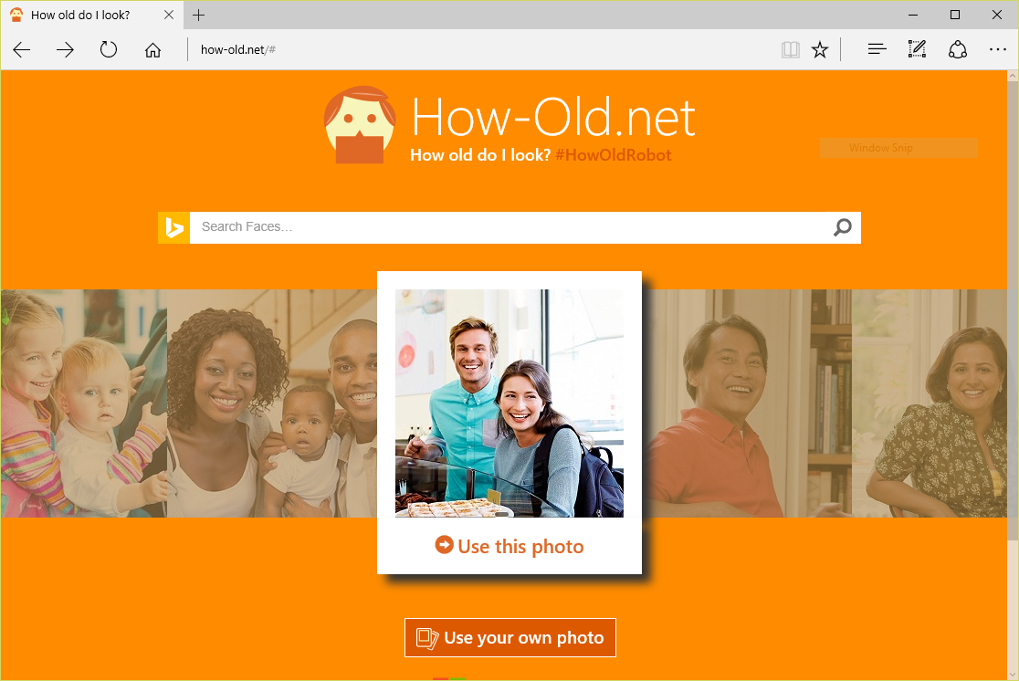
Machine Learning in Action:
#CodeSizzler | #AzureML

Slide 8
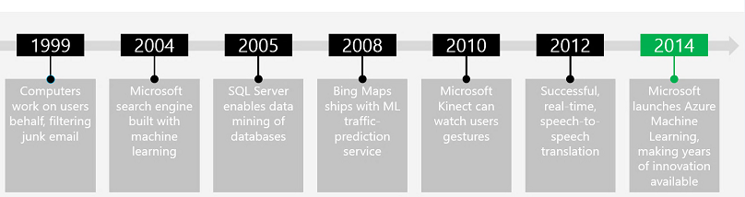


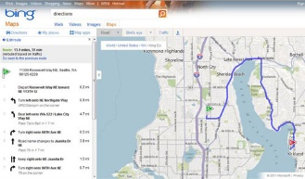
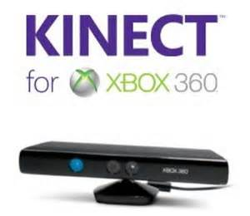
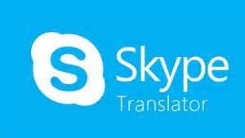


Microsoft & ML:
#CodeSizzler | #AzureML
Notes:
Microsoft has a rich history of employing machine learning in their products, beginning with the Silicon Valley company they purchased in 1999 and created Hotmail from. Hotmail used ML to perform advanced spam detection.

Slide 9
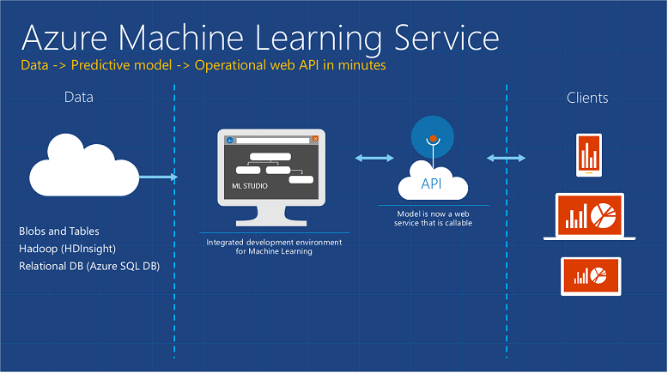
#CodeSizzler | #AzureML

Slide 10
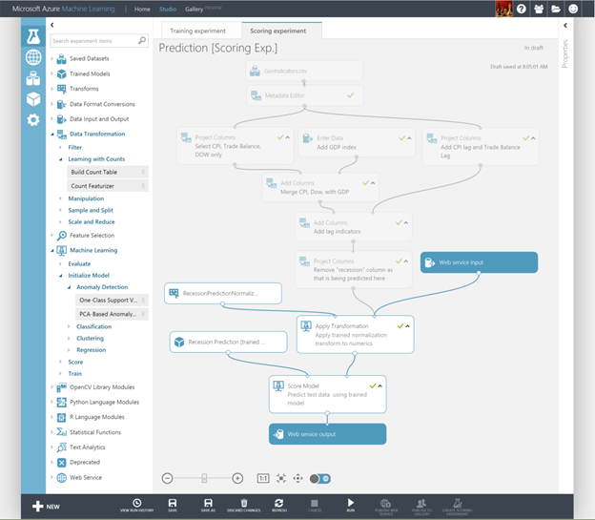
Getting started in ML Studio:
Visual editor for composing, testing, refining, and deploying machine-learning models
Includes hundreds of modules
Includes common algorithms for classification, regression, and more
Supports numerous input formats
Supports R and Python
Machine Learning for the masses
#CodeSizzler | #AzureML
Notes:
ML Studio simplifies machine learning by providing a drag-and-drop model in which you build workflow. With ML Studio and the rich of assortment of modules it offers for modeling workflow, you can often build sophisticated models without writing a single line of code. However, it allows you to insert R and Python code anywhere in the workflow, providing infinite flexibility in what you can model.

Slide 11
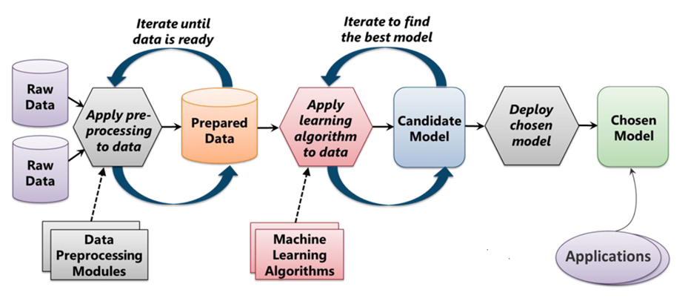
Machine Learning Process:
From "Introduction to Microsoft Azure" by David Chappell
#CodeSizzler | #AzureML

Slide 12
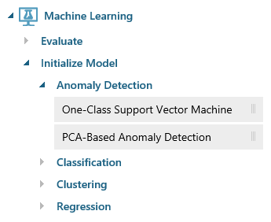
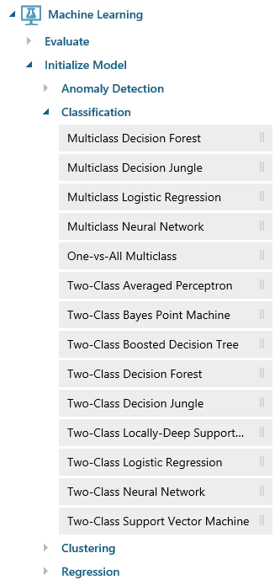
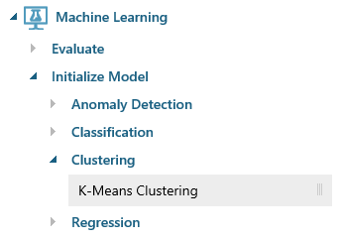
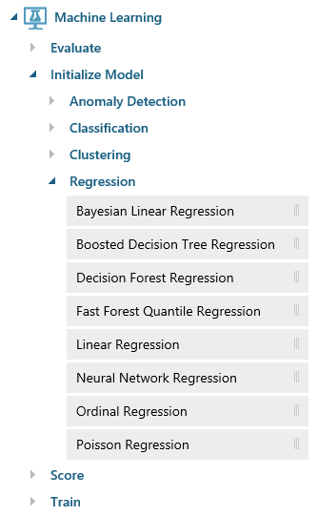
Azure Machine Learning Algorithms:
#CodeSizzler | #AzureML
Notes:
ML Studio provides canned implementations of 25 of the classic algorithms used in machine learning. It divides them into four categories.
Anomaly detection is the identification of items, events, or observations which do not conform to an expected pattern or other items in a dataset. A classic example is examining a dataset representing banking transactions and detecting potentially fraudulent transactions in that group.
Regression algorithms seek to establish and quantify relationships between variables. By establishing a relationship between a dependent variable and one or more independent variables, regression analysis can enable the value of a dependent variable to be predicted given a set of inputs with a quantifiable accuracy. A great example can be seen at https://how-old.net/#, a site that lets you upload a photo and then guesses your age with uncanny accuracy. The site uses Azure Machine Learning and combines classic regression with advanced image recognition.
The purpose of classification algorithms is to identify the category to which an observation belongs based on training data consisting of observations which have already been classified (assigned to a category). A great example is determining whether an e-mail belongs to the "spam" category or the "not-spam" category.
Clustering seeks to group a set of objects in such a way that objects in the same group (called a cluster) are more similar to each other than to those in other groups (clusters).

Slide 13
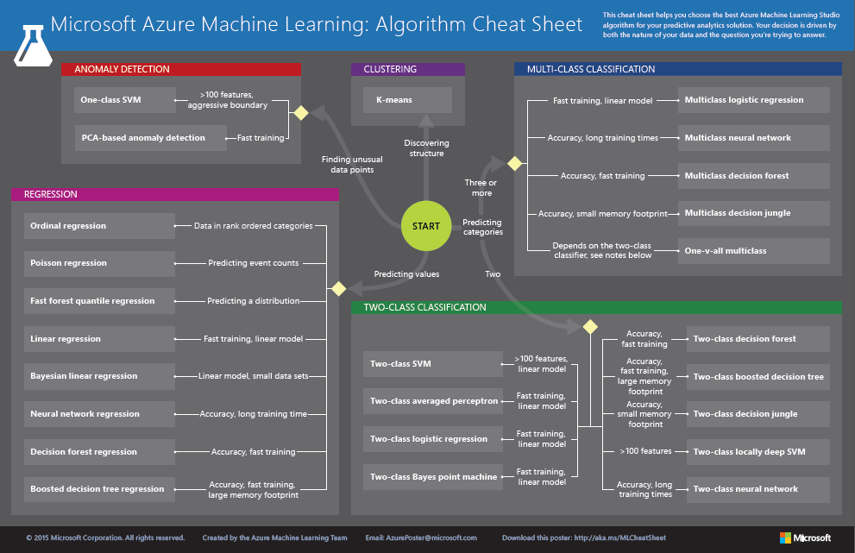
http://aka.ms/MLCheatSheet
Notes:
The Azure ML Cheat Sheet helps you pick the right algorithm for a model, even if you're not a trained data scientist. One example is if you want to use a set of input values to predict an output value from a continuous set of values (e.g., a person's age), use linear regression. But if you're more interested in the distribution of the output, you might use fast forest quantile regression instead. An example of when you would use the latter is using growth charts to assess child development. "Abby's height is in the 10% quantile of the heights of kids her age." Classification algorithms, by contrast, are used to predict a value from a discrete set of values -- for example, classifying an e-mail as spam or not spam.

Slide 14
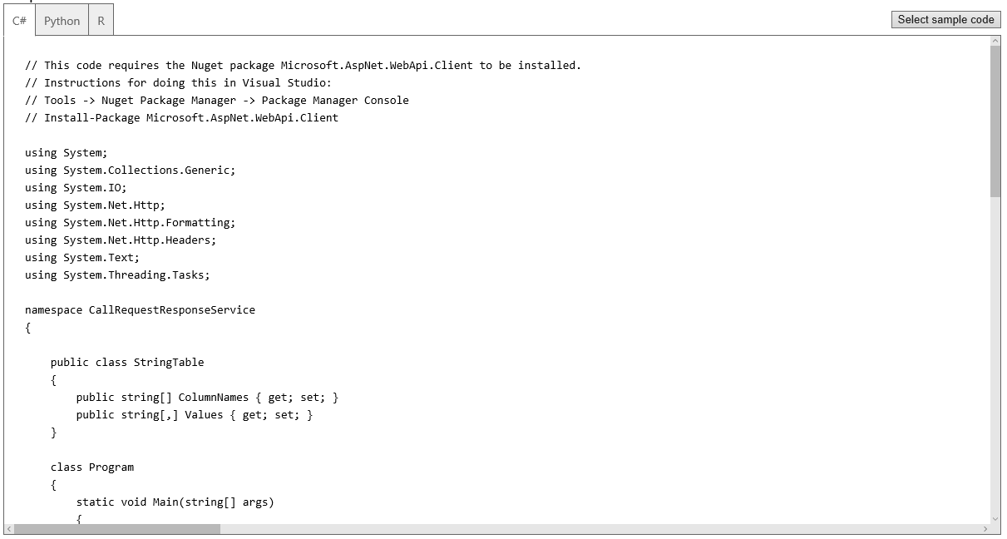
Deploying as a Web Service
A button click in ML Studio deploys a model as a Web service and provides sample code for calling it in three languages
#CodeSizzler | #AzureML
Notes:
Once deployed as a Web service, a model can be used with simple REST calls over HTTP. This enables developers to build "smart apps" that get their intelligence from ML. In the next lab, students will build and train an ML model, deploy it as a Web service, and then write a client app that uses it.

Slide 15
Loading Data in Azure ML

Slide 16
Getting started in Azure ML Studio:
https://studio.azureml.net/
#CodeSizzler | #AzureML

Slide 17
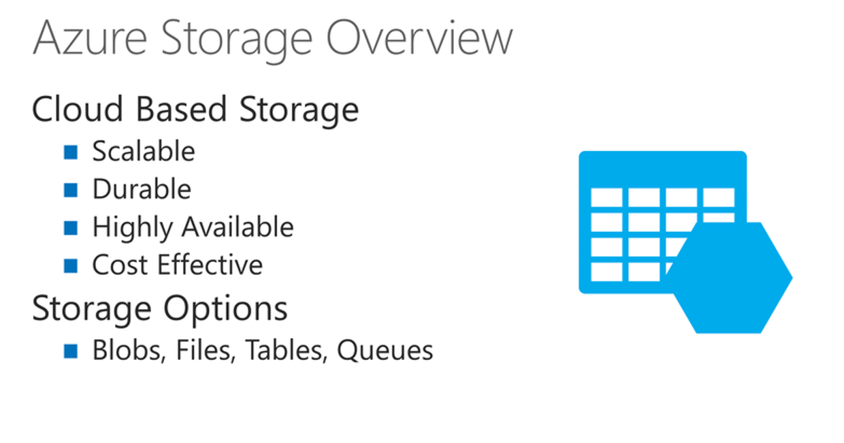
Brief introduction into Azure Storage:
#CodeSizzler | #AzureML
Notes:
Azure storage is a highly available, multi-tenant service designed for flexible storage options.
It consists of 4 services: Blobs, Files, Tables and Queues
What is Multi tenant –
The term "software multitenancy" refers to a software architecture in which a single instance of software runs on a server and serves multiple tenants. A tenant is a group of users who share a common access with specific privileges to the software instance.

Slide 18
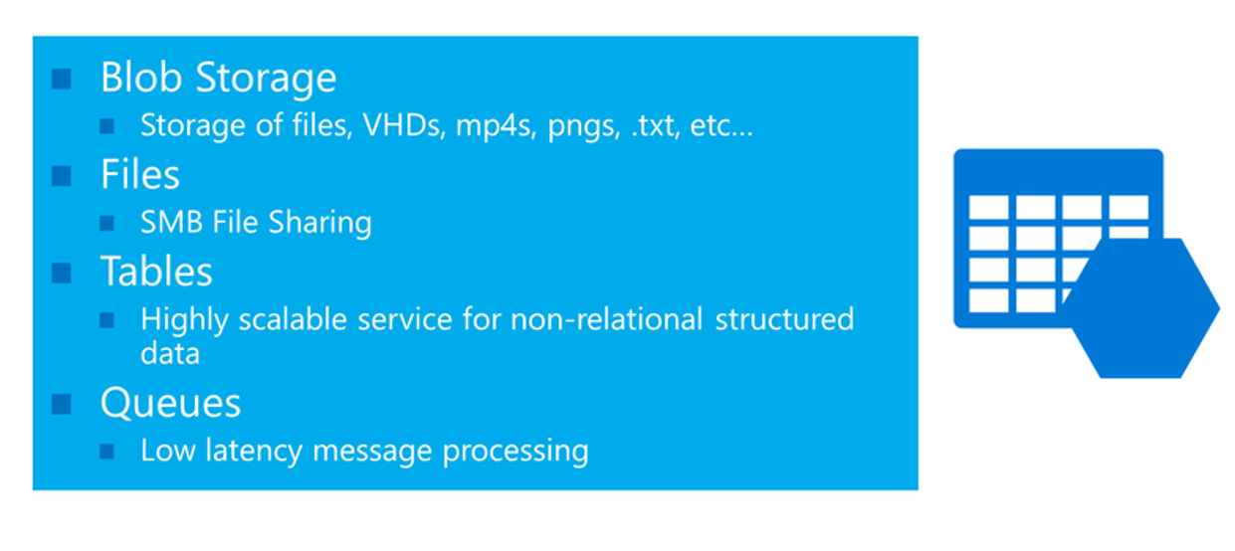
#CodeSizzler | #AzureML
Notes:
SMB file sharing - In computer networking, Server Message Block (SMB), one version of which was also known as Common Internet File System (CIFS, /ˈsɪfs/),[operates as an application-layer network protocol^{[3]} mainly used for providing shared access to files, printers, and serial ports and miscellaneous communications between nodes on a network.

Slide 19
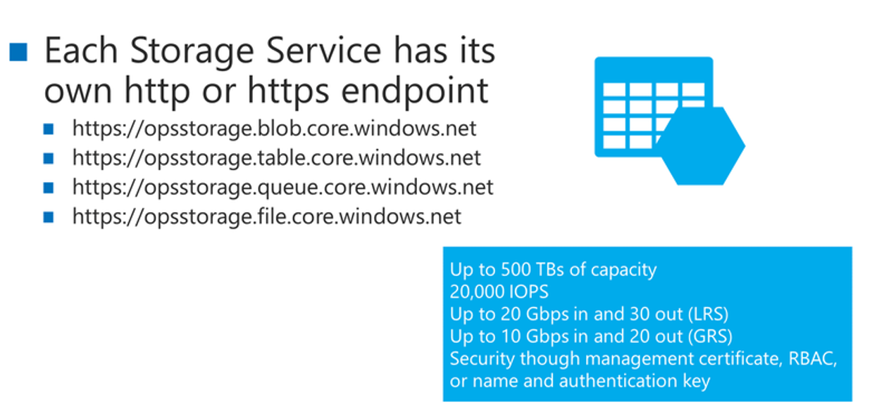
#CodeSizzler | #AzureML

Slide 20
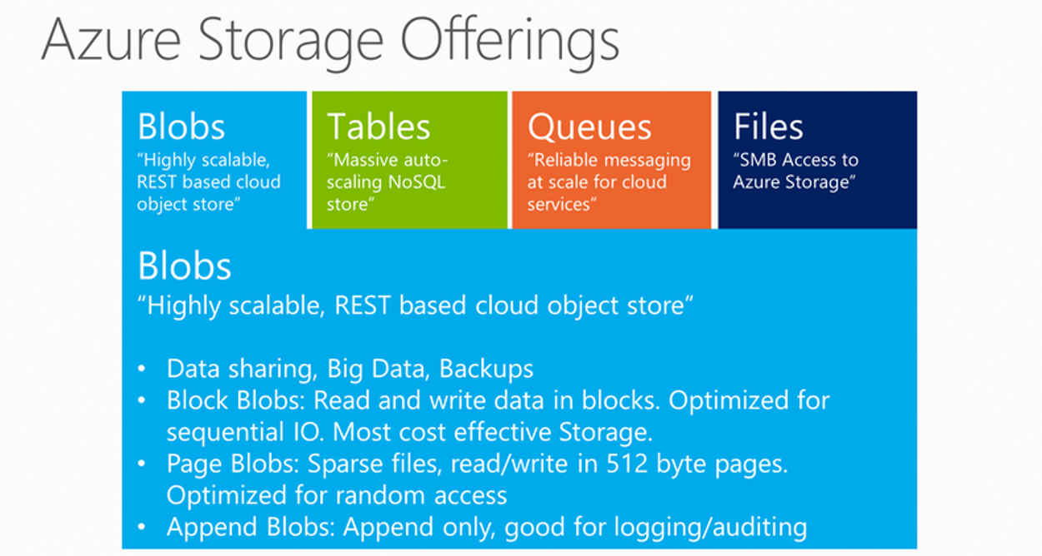
#CodeSizzler | #AzureML

Slide 21
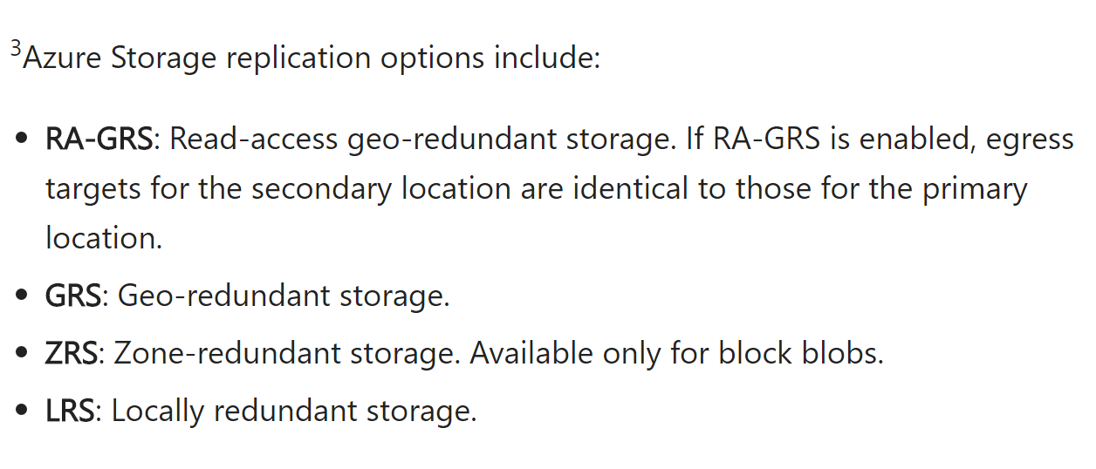
Replications on Azure Storage:
#CodeSizzler | #AzureML

Slide 22
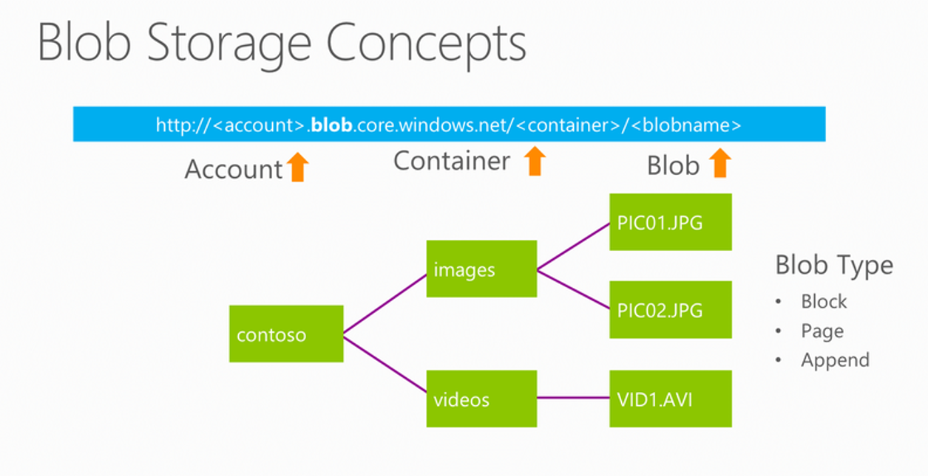
#CodeSizzler | #AzureML

Slide 23
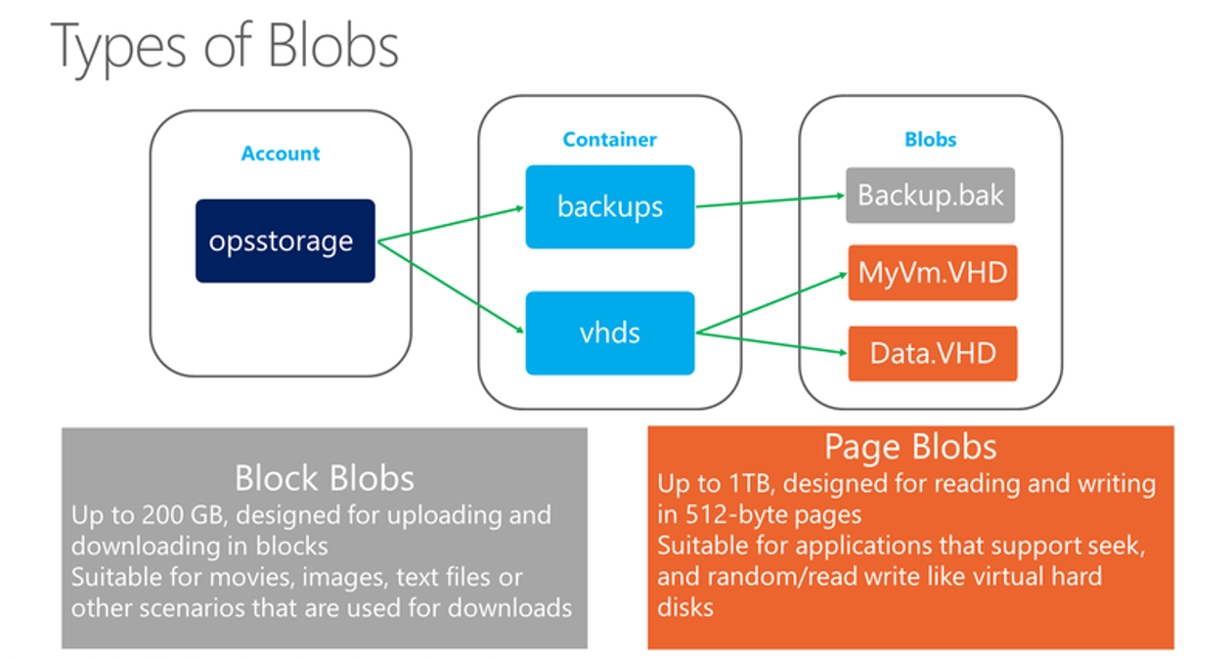
#CodeSizzler | #AzureML

Slide 24
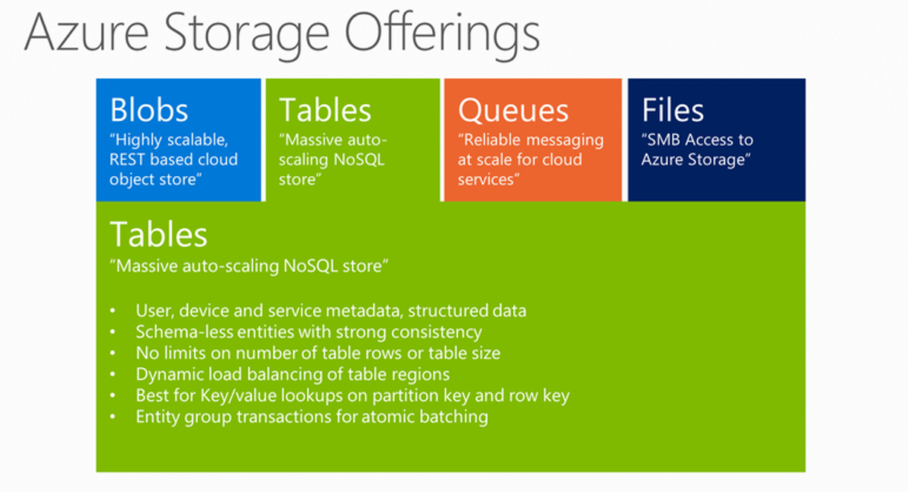
#CodeSizzler | #AzureML

Slide 25
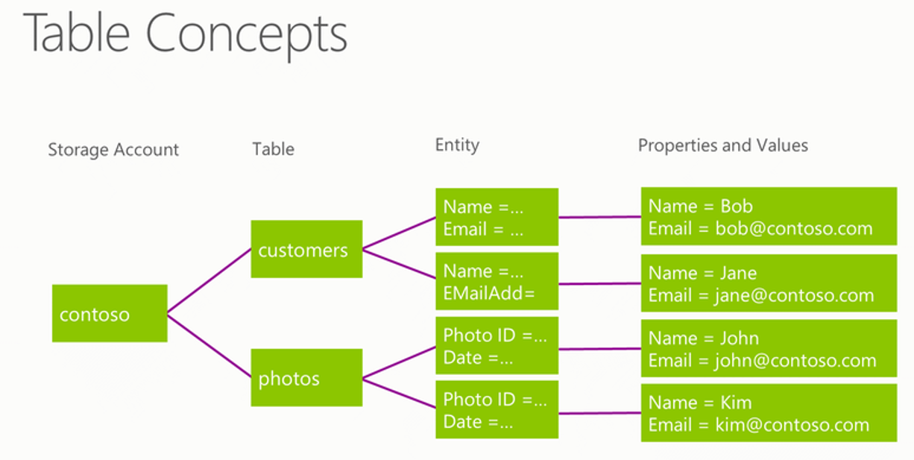
#CodeSizzler | #AzureML

Slide 26
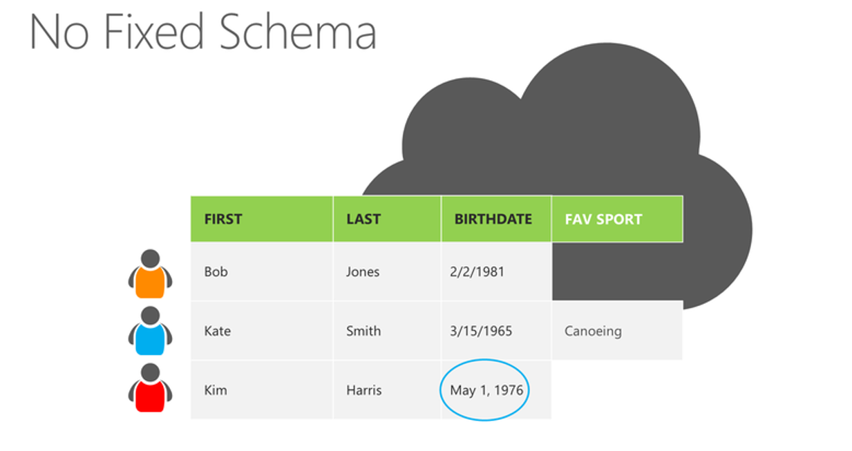
#CodeSizzler | #AzureML

Slide 27
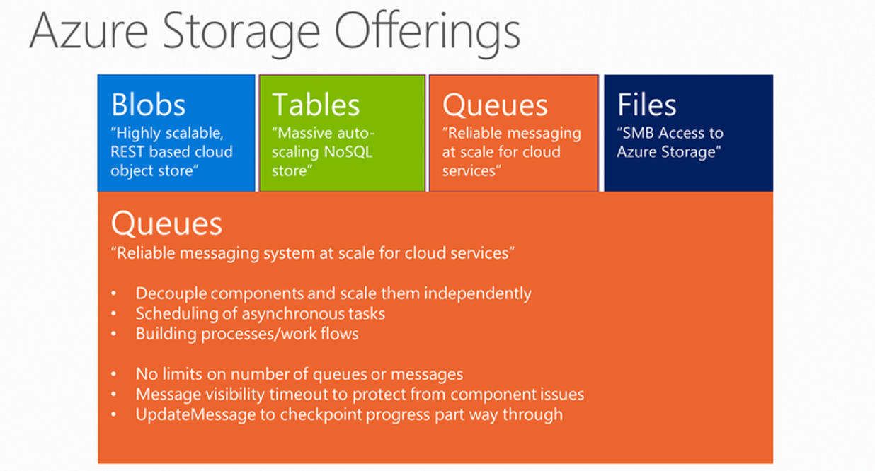
#CodeSizzler | #AzureML

Slide 28
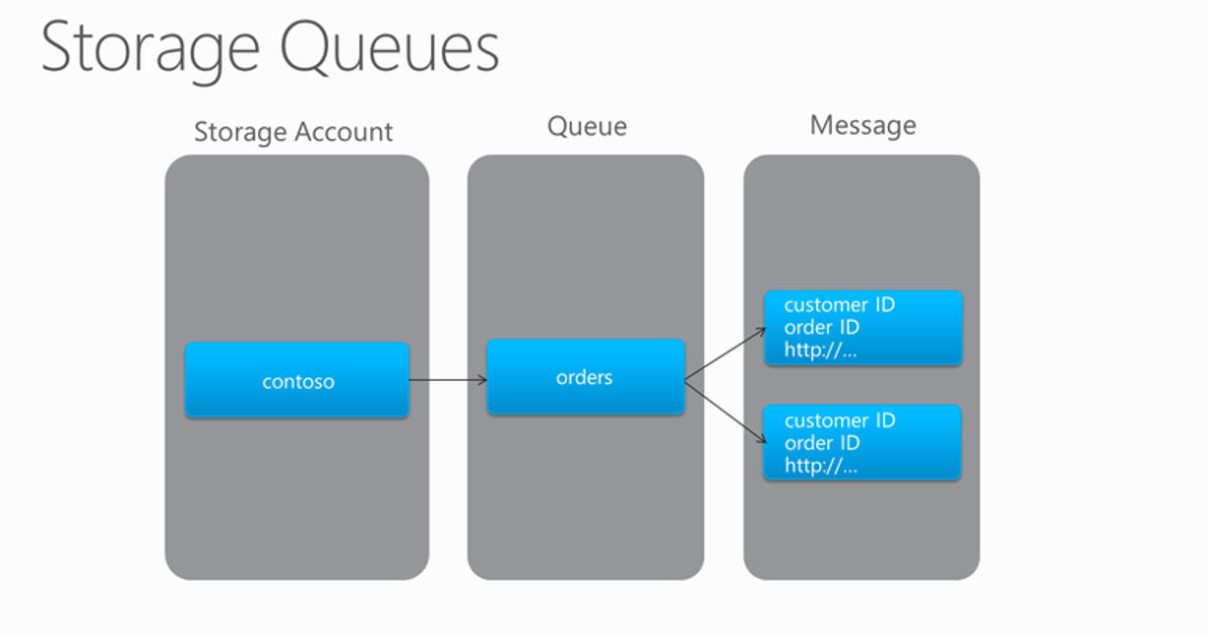
#CodeSizzler | #AzureML

Slide 29
#CodeSizzler | #AzureML

Slide 30
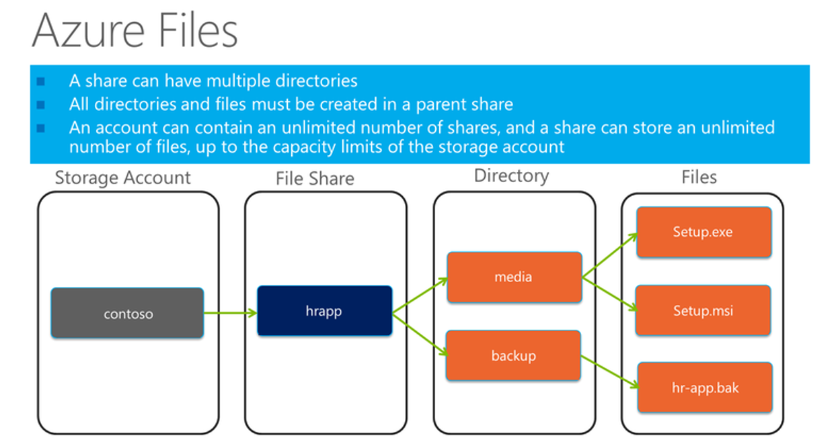
#CodeSizzler | #AzureML

Slide 31
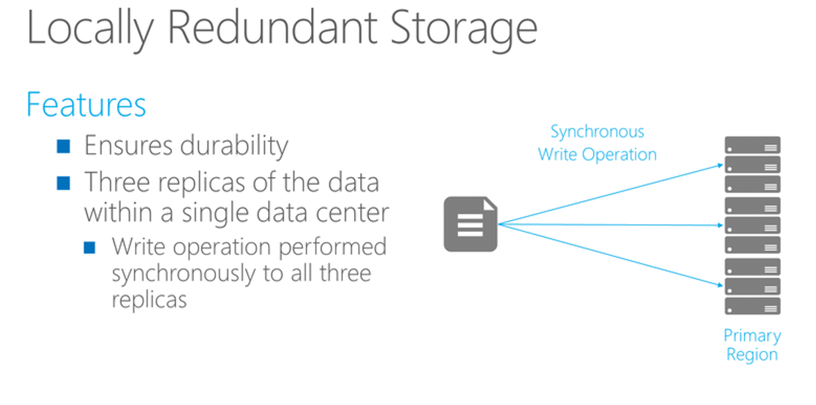
#CodeSizzler | #AzureML

Slide 32
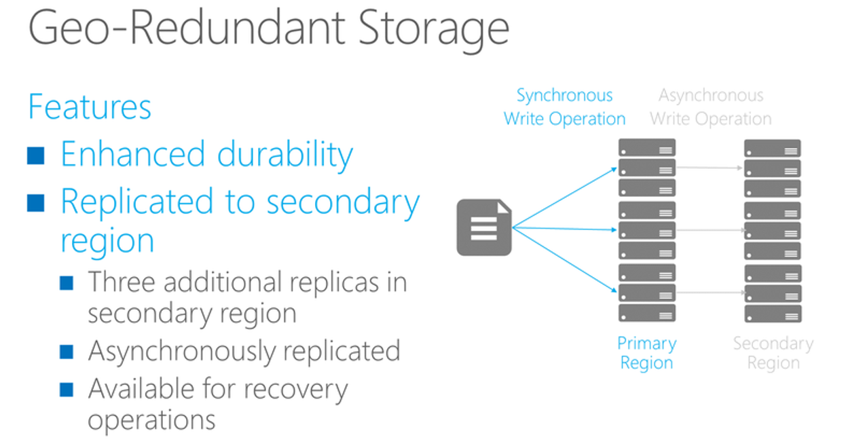
#CodeSizzler | #AzureML

Slide 33
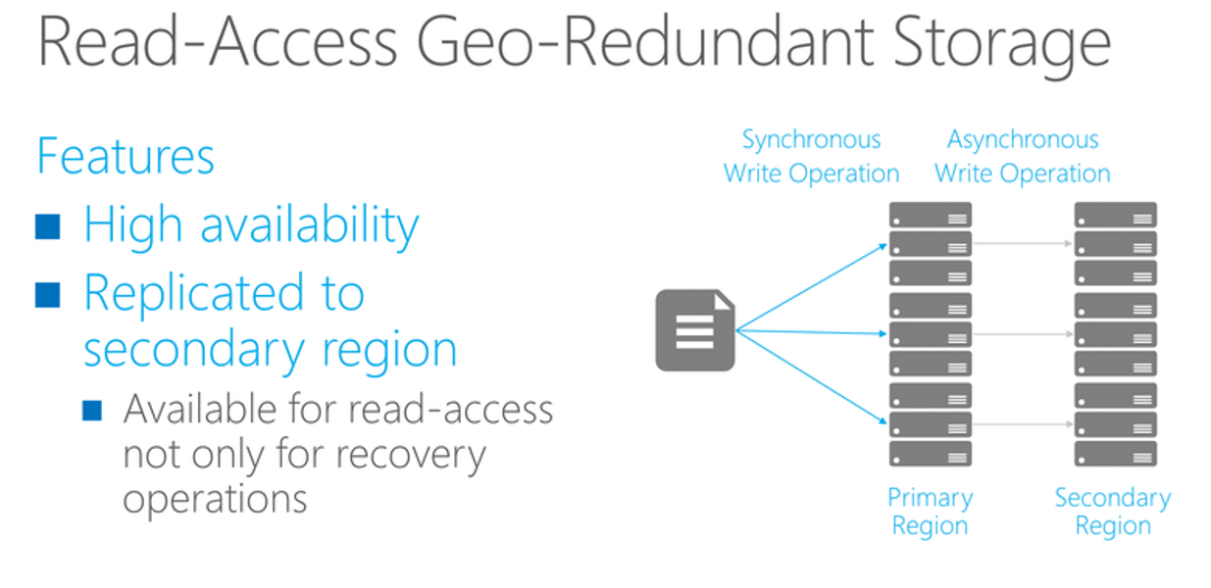
#CodeSizzler | #AzureML

Slide 34
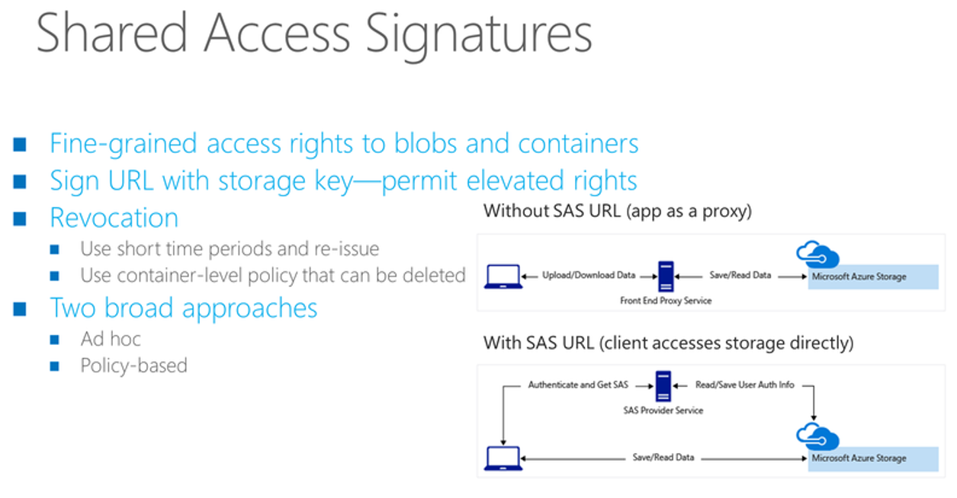
#CodeSizzler | #AzureML

Slide 35
Working with sample datasets:
Notes:
Saved Datasets in Workspace

Slide 36
Uploading Custom Datasets

Slide 37
R with Azure ML

Slide 38
Azure Storage with datasets – Import Data

Slide 39
Setup your model in Cortana Intelligence Gallery

Slide 40

Enter Text
Thanks for Joining!!
Abdul Rasheed Feroz Khan
Feel free to reach me for any queries:
@TechFero | @CodeSizzler
developer.fero@outlook.com

